Slide 1

MLSA LearnBot by Team StarLabs
Solution Type: AI and Application Development (Prototype)
Name of Team Members:
Damilare AKINYEMI (Lead)
Taiwo OMOYENI
Emmanuel OMOLAJA
Jessica ESCOBEDO
Notes:
Korrie

Slide 2

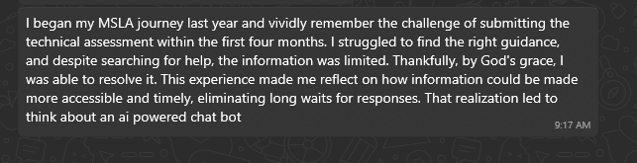

The Opportunity
We've all been there — stuck in a loop, trying to find the right information, only to end up more confused and frustrated. Whether it's navigating through countless documents or waiting for responses, finding the help you need can sometimes feel like a daunting task.
This struggle is particularly true for Student Ambassadors who often need quick and accurate information to support their roles. The process of sifting through resources can be time-consuming, leaving them with less time to focus on what really matters — engaging with their peers and making an impact.
Notes:
Korrie
updated 7/21

Slide 3

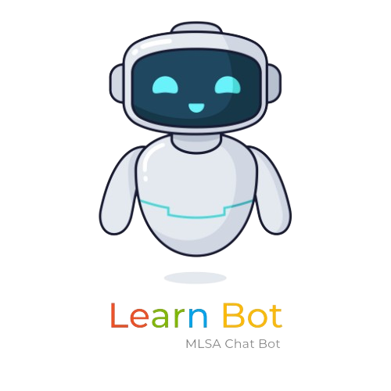
Solution
That's where our solution comes in. We set out to build an Intelligent Chatbot (Question-and-Answer) app designed specifically for Student Ambassadors.
Our goal?
To leverage cutting-edge AI and ensure that finding help and information is as seamless and efficient as possible.
With our chatbot, Student Ambassadors can get instant answers to their questions, access relevant resources, and navigate their responsibilities with confidence—all within a single, user-friendly interface
Notes:
Korrie
updated 7/21

Slide 4

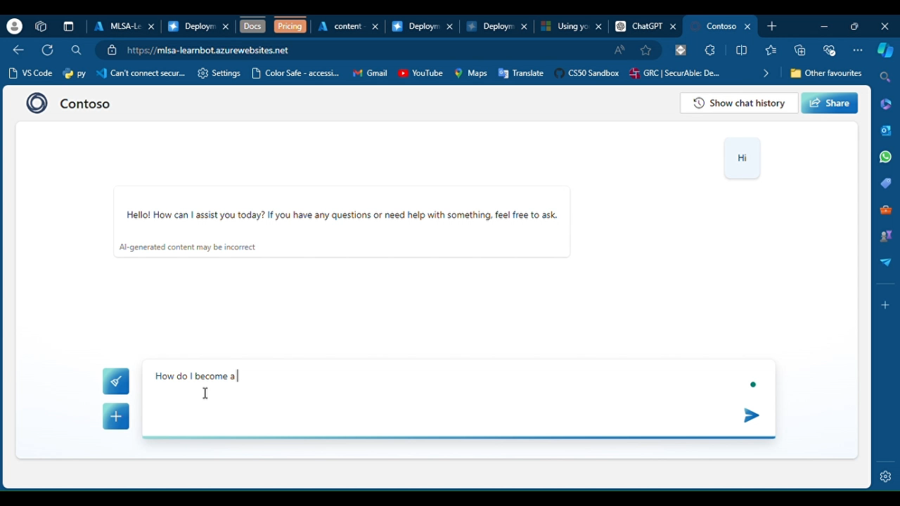
Demo
Notes:
Korrie
updated 7/21

Slide 5
Technologies Used
To build this powerful tool, we utilized a robust stack of technologies, including;
Azure Web App for seamless deployment
Azure AI Search for enhanced search capabilities
OpenAI for natural language processing
The development process was streamlined with GitHub for version control
Visual Studio Code as our primary IDE
Copilot for AI-assisted coding.
Additionally, Microsoft Word was used for documentation
Notes:
Korrie
updated 7/21

Slide 6
Takeaways
What do we recommend our audience start doing?
To start using AI-powered solutions like our chatbot to quickly access accurate and relevant information. Start leveraging technology that is designed to simplify and streamline their workflow.
What can be done without you?
The chatbot can operate autonomously, providing instant responses to queries without requiring constant human intervention. Users can continue to use the chatbot to find information and resources at any time, without bothering the support team.
Notes:
Korrie
updated 7/21

Slide 7
Takeaways
How could our solution speed up the process or simplify it?
Speed Up the Process: Our AI-driven chatbot drastically reduces the time spent searching for information by delivering answers in real-time. Users might no longer need to navigate multiple sources, and the wait time for human assistance would be significantly reduced.
Simplify It: The chatbot offers a single, user-friendly interface that consolidates all necessary information and resources, making the search process intuitive and straightforward.
Notes:
Korrie
updated 7/21

Slide 8
Links
Bot: https://mlsabot.azurewebsites.net/
Repo: https://github.com/shunlexxi/mlsalearnbot

Slide 9
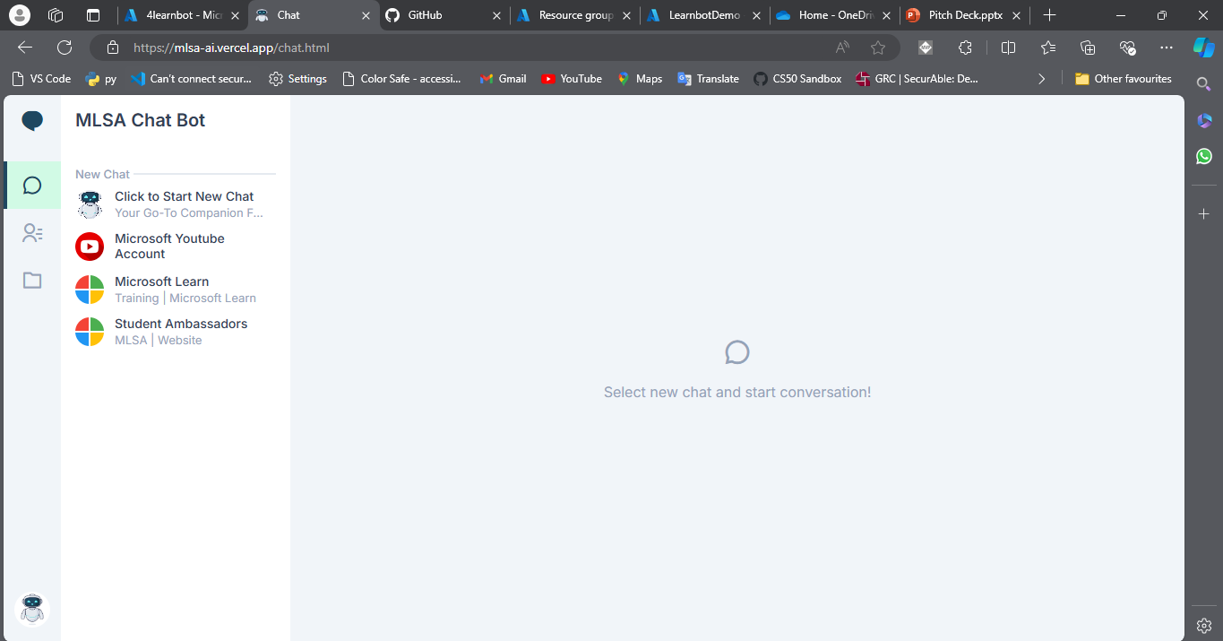
Future Plans: New UI https://mlsa-ai.vercel.app
Notes:
Korrie
updated 7/21

Slide 10


Notes:
Korrie
updated 7/21

